Slide 1
INCLUDING FAMILY AND COMMUNITY IN THE RECOVERY PROCESS
Presented by William “Bill” White and Joe Powell
June 19, 2013
A presentation by the NAADAC, the Association for Addiction Professionals

Slide 2
INCLUDING FAMILY AND COMMUNITY IN THE RECOVERY PROCESS
Presented by William “Bill” White and Joe Powell
June 19, 2013
A presentation by the NAADAC, the Association for Addiction Professionals

Slide 3
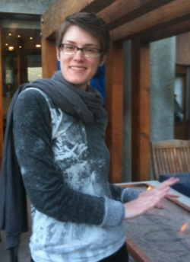
WEBINAR ORGANIZER
Misti Storie, MS, NCC
Director of Training & Professional Development
NAADAC, the Association for Addiction Professionals

Slide 4
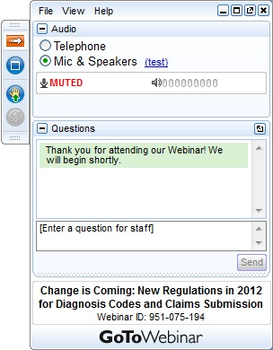
USING GOTOWEBINAR
Control Panel
Asking Questions
PowerPoint Slides
Audio (phone preferred)
www.naadac.org/education/webinars
www.myaccucare.com/webinars

Slide 5
A presentation by NAADAC, the Association for Addiction Professionals
Hosted by our Technology Partner

Slide 6
A COMPONENT OF THE RECOVERY TO PRACTICE (RTP) INITIATIVE www.naadac.org/education/recovery

Slide 7
OBTAINING CE CREDIT
The education delivered in this webinar is FREE to all professionals.
2 CEs are FREE to NAADAC members and AccuCare subscribers who attend this webinar. Non-members of NAADAC or non-subscribers of AccuCare receive 2 CEs for $25.
If you wish to receive CE credit, you MUST complete and pass the “CE Quiz” that is located at: (look for TITLE of webinar)
www.naadac.org/education/webinars
www.myaccucare.com/webinars
A CE certificate will be emailed to you within 21 days of submitting the quiz and payment (if applicable) – usually sooner.
Successfully passing the “CE Quiz” is the ONLY way to receive a CE certificate.
Free to NAADAC Members and AccuCare Subscribers

Slide 8
WEBINAR LEARNING OBJECTIVES
Describe how the family and community have been affected by addiction
List 3 strategies for including individuals, family members and the community in the recovery programs
Define community recovery capital
Identify how to assess community recovery capital

Slide 9
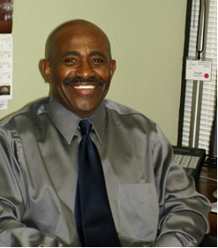
WEBINAR PRESENTER #1
Joe Powell
Executive Director
Association of Persons Affected by Addiction (APAA)
Joep2722@aol.com

Slide 10
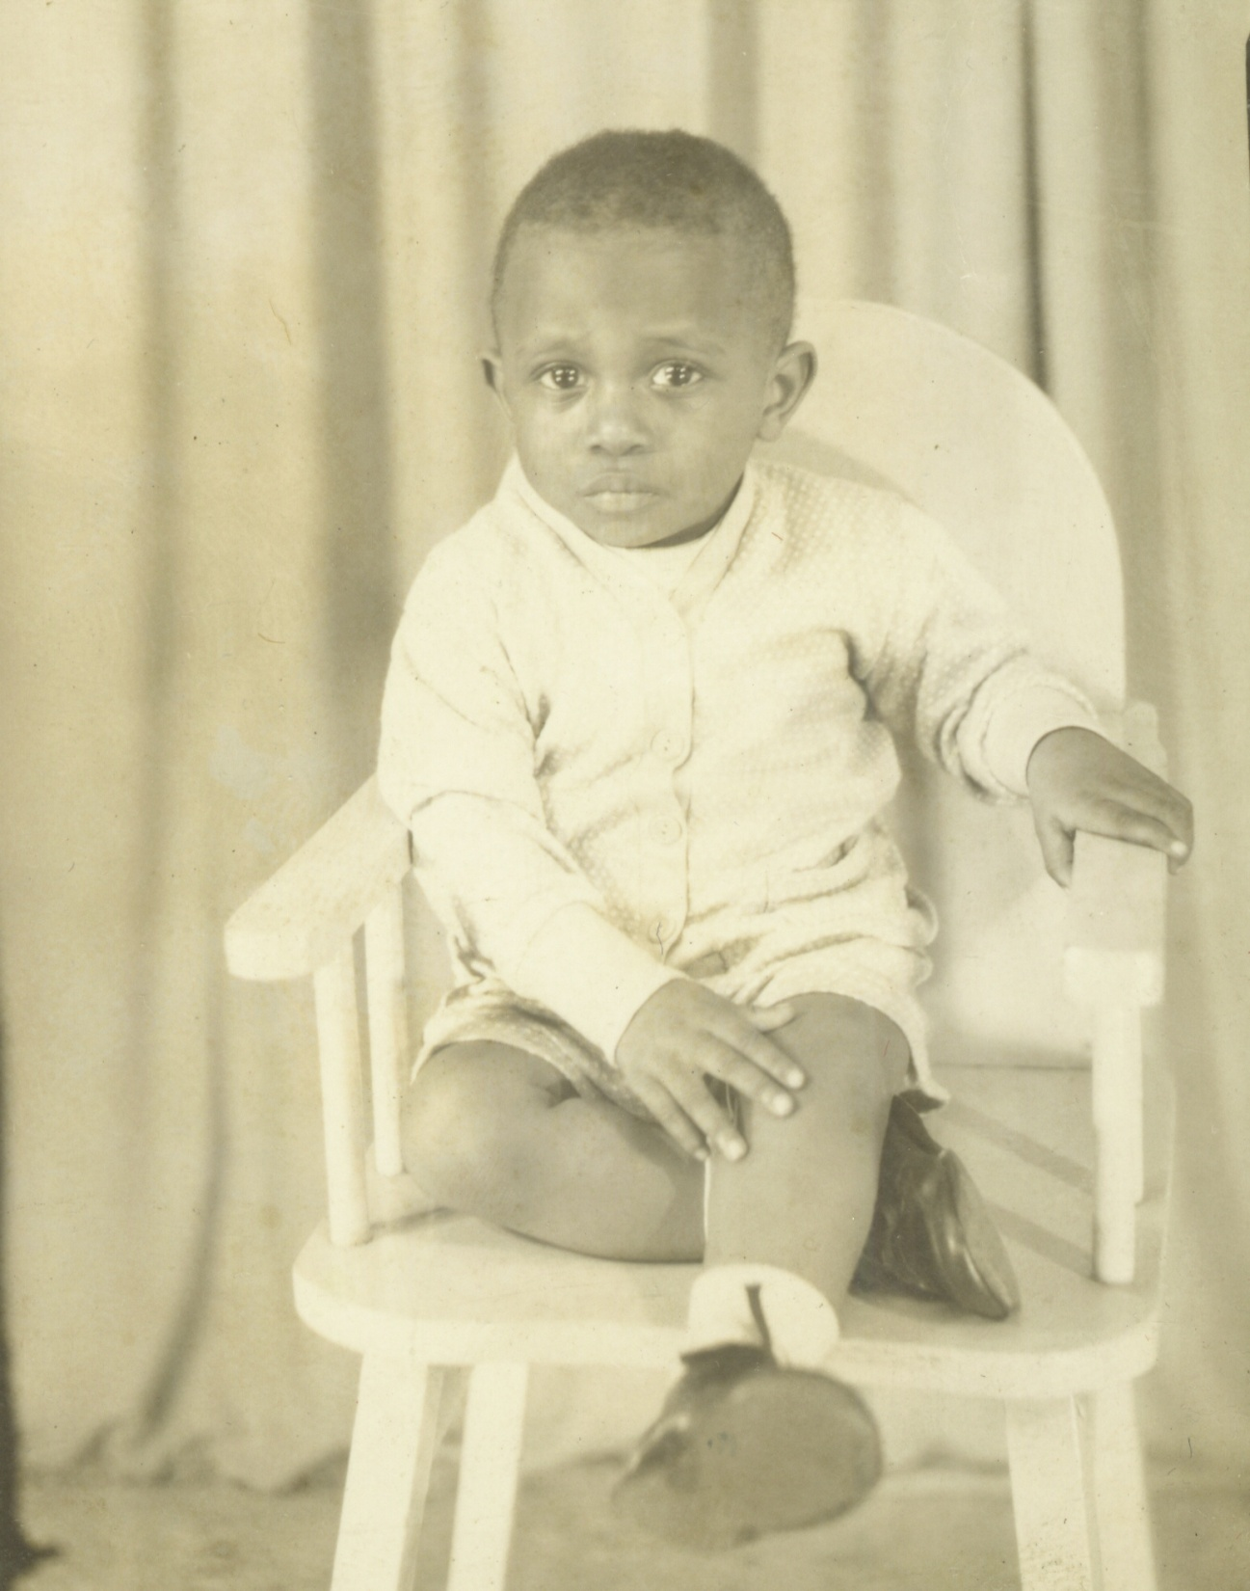
JOE POWELL – PERSON IN LONG-TERM RECOVERY
Notes:
My name is Joe Powell and I am a person in long Term Recovery and that means, I have not had a drink of Alcohol in 24 years.

Slide 11
WHO IN THE FAMILY IS AFFECTED BY THE DISEASE OF ADDICTION
The family follows a predictable and progressive course in response to living in an environment where the disease of addiction is active.
Similar signs and symptoms of the alcoholic/addict.
Tolerance of the addict
Denial of the Elephant
Plays detective
Preoccupied with addict
Tries to hide the problem from family and friends
Continue to make excuses and cover for addict
Lose friends and family
Develop ulcers, headaches, nervous breakdowns, depression

Slide 12
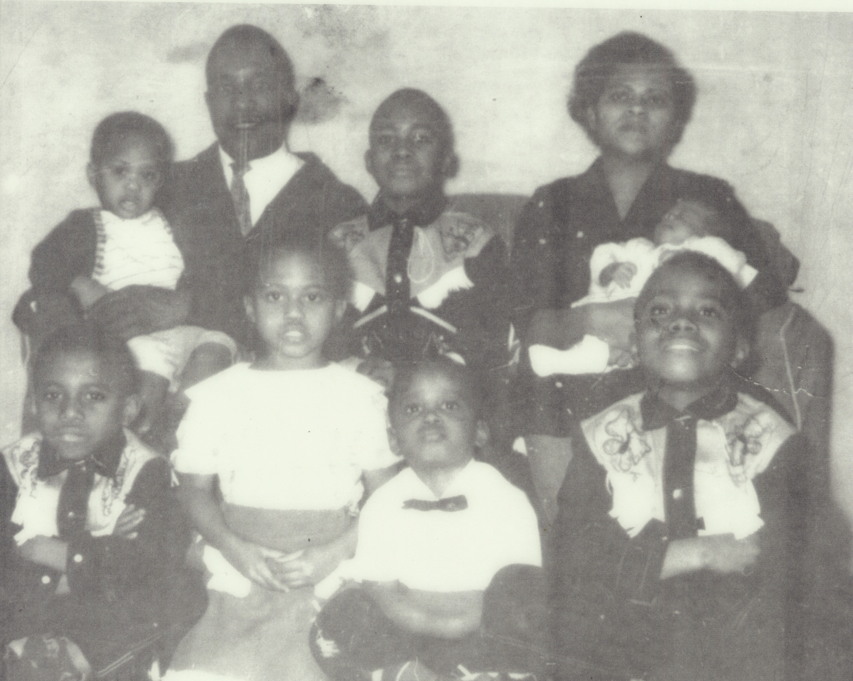
Notes:
Affects the whole family

Slide 13
WHO IN THE FAMILY IS AFFECTED BY THE DISEASE OF ADDICTION
We develop our first sense of who we are, how the world works and how we fit into the world in our family of origin.
The addicted family member matters more than the family as an entity. (Family denial)
The primary enablers in a chemically dependent family is usually someone who is emotionally connected to the addict. (The whole family)
Parents, spouses and children of the addict/alcoholic have hidden their most life-shaping experiences behind a veil of silence and secrecy.
Notes:
The Whole Family

Slide 14
SUBSTANCE USE DISORDER FAMILY SHAME
Shame: Family problems should stay within the family - Influencing how they reach out to others for help, their initial reactions in counseling process
The "don't trust" rule means:
don't trust anybody outside the family
don't trust the police
don't trust the addict or your own perceptions

Slide 15
SUBSTANCE USE DISORDER FAMILY SHAME
Shame: Family problems should stay within the family - Influencing how they reach out to others for help, their initial reactions in counseling process
The "don't talk" rule means:
don't tell other people about family problems
don't talk about problems with other family members
don't speak until spoken to

Slide 16
SUBSTANCE USE DISORDER FAMILY SHAME
Shame: Family problems should stay within the family - Influencing how they reach out to others for help, their initial reactions in counseling process
The "don't feel" rule means:
Don’t get angry (Mad)
Don’t get depressed (Sad)
Don’t be afraid (Scared)

Slide 17
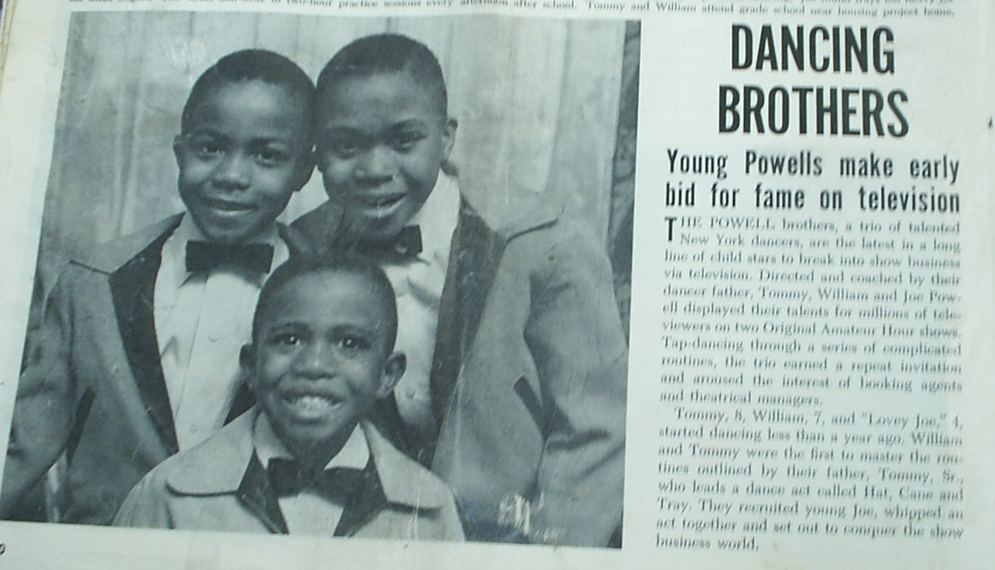

Slide 18
OUTSIDE FAME BUT INSIDE SHAME
The Learning Phase
Family members gradually become aware of stress in the family.
Family relationships become strained: arguments, tension, domestic violence, less communication, etc.
Family members begin to experiment with defensive behaviors.
Learning may not be conscious, but is strong and habit-forming.

Slide 19
FOREVER, MY FAULT
The Harmful Phase
Family members' defensive behaviors become automatic and compulsive.
The family blames the chemically-dependent person.
Family members feel helpless to control the chemical use and begin to believe that they and their behavior were the cause of the problem, leading to feelings of guilt, shame and self-blame.
Family members deny their own pain.

Slide 20
ACTING OUT FAMILY SHAME
The Escape Phase
Repeated major crises become routine occurrences.
Family members suffer overpowering feelings of rage, guilt, and disloyalty regarding the chemically-dependent person, and seriously begin to look for ways to escape.
Separation, desertion, and sometimes suicide are seen as the only way out.
At this stage, separation from the dependency situation is not enough. All members of the family need help.

Slide 21
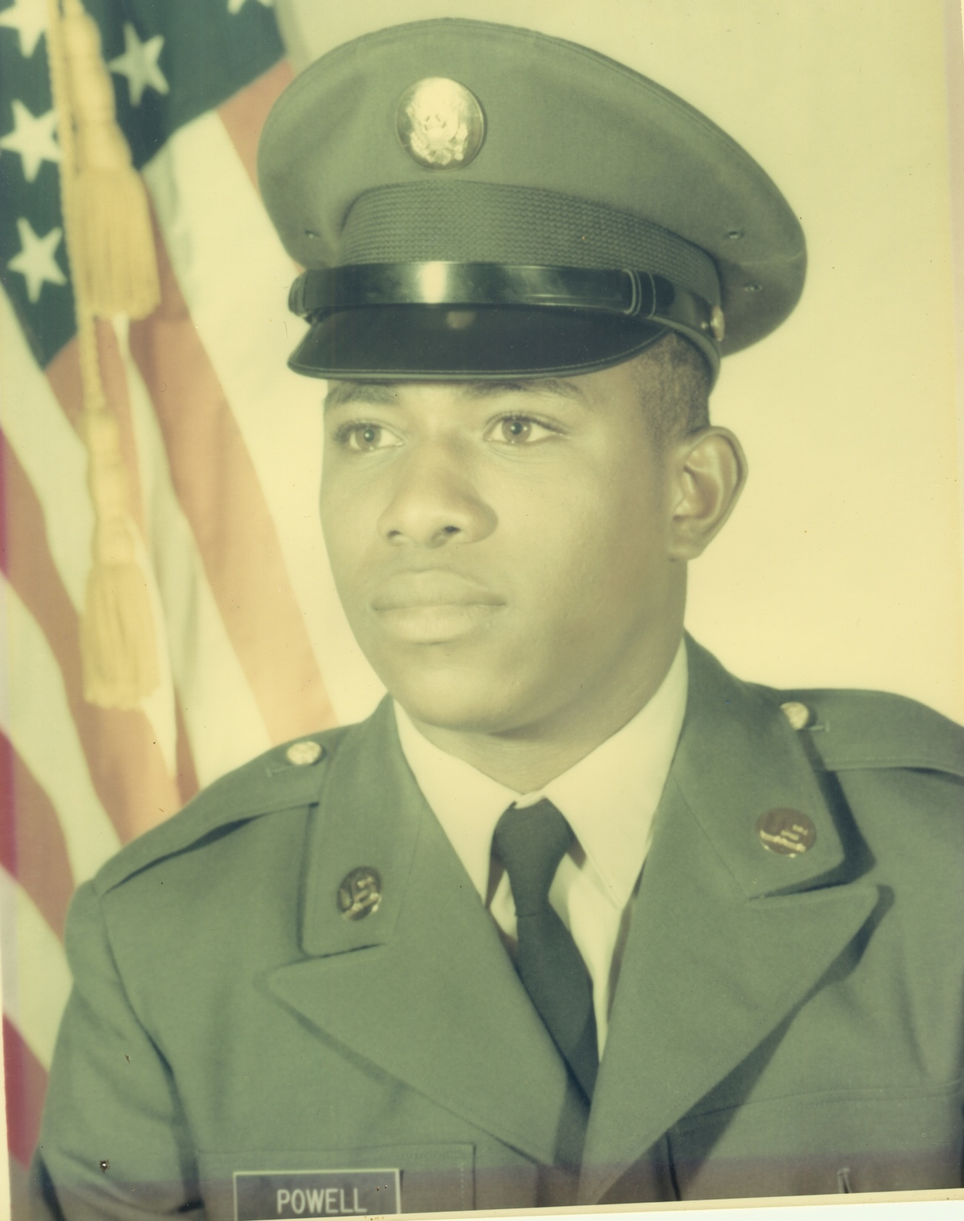
Notes:
I survived the disease of my parents only to acquire it myself.

Slide 22
FAMILY DENIAL
Enabling = any actions which prevent the alcoholic from experiencing the consequences of their drinking behavior
Acknowledging the problem and adopting a pattern of tough love could speed up the day when the alcoholic “hit bottom” and initiated recovery.
Reverend Vern Johnson felt there had to be a better way to intervene in alcoholism than to sit and wait for the alcoholic to hit bottom.
He developed a technology of family intervention through which the bottom could be raised to meet the alcoholic.
He pioneered the use of a loving confrontation between the alcoholic and those who cared for the alcoholic to precipitate a crisis that most often resulted in the alcoholic’s entry into alcoholism treatment.

Slide 23
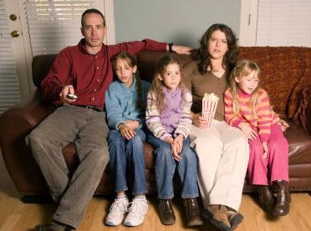
AFFECT ON THE FAMILY
The family does what they do out of a sincere desire to help the alcoholic and to maintain the family.
With the crisis of addiction/alcoholism, the traditional tools of family problem solving and crisis reaction do not work.

Slide 24
AFFECT ON THE FAMILY
Families are made dysfunctional by the attempt to cope with alcoholism/addiction in the only way they know.
After all they have done, they think they fail in the role of wife, husband, parent or children. They try harder. They take on the responsibilities of the alcoholic, not realizing that this causes the alcoholic to become irresponsible.

Slide 25
AFFECT ON THE FAMILY
They have tried what religion, society and our culture has taught them. It doesn’t work and the resulting despair and guilt bring about confusion and chaos.
As the alcoholic must be viewed as a victim of a disease, so must the characteristics of the concerned persons be viewed as a reaction to the progressive stress of the disease.
Their behavior has a very immediate motivation: stabilization of the family.
In the context of what is best for the alcoholic, behavior of a concerned person may be dysfunctional; but, in the context of the rest of the family, the behavior might appear quite functional.

Slide 26
Notes:
Affects the whole family

Slide 27
SURVIVAL ROLES IN THE FAMILY & COMMUNITY
The common denominator among these roles is that each in its own way is an attempt to survive, a coping strategy.
These roles are seen as providing children and adolescents with support and approval from persons outside the home, from adults or peers.
For example, the responsible one probably is a good student, mommy’s little helper, and gets praise for both. The danger to a youth is becoming frozen in an adopted role. The role can become a lifetime pattern.

Slide 28
SURVIVAL ROLES: CODEPENDENT
The Victim/Dependent person
Primary Enabler
The Frustrated Parent
The Hero
The Scapegoat
The Lost Child
The Mascot
I survived the disease of my parents only to acquire it myself.

Slide 29
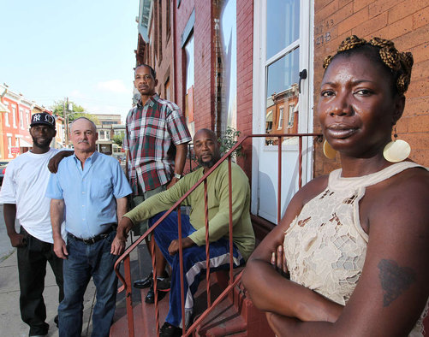
AFFFECT ON THE COMMUNITY
The impact and affect of addiction/alcoholism is visible throughout the community with alcoholism, drug addiction, liquor stores, drug dealing, in schools, entertainment, poverty, housing, domestic violence, social impact, unemployment, rites of passage and mental illness
The community have stuffed its feelings from their traumatic wounds and have lost the ability to feel or express their truths because it hurts too much.

Slide 30
AFFFECT ON THE COMMUNITY
The recommendation to seek help is particularly vital, considering the majority of people with diagnosable disorders, regardless of race or ethnicity, do not receive treatment in the community.
The stigma surrounding addiction is a powerful barrier to reaching treatment. People with addiction/mental illness feel shame and fear of discrimination about a condition that is as real and disabling as any other serious health condition.

Slide 31
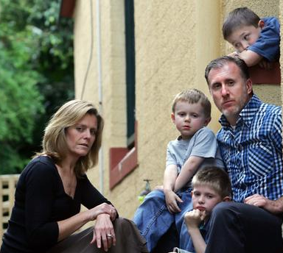
FAMILY DENIAL
Repeated Modeling Childhood
Always Confused
Cannot Please Family
Repeat Mistakes
Unreal Expectations of Life
Mixed Messages
“I love you/Go away”
“Cannot do Right/I Need You”
“Always tell the Truth/I don’t want to know”
“I’ll be There for You/Then Forget”

Slide 32
COMMUNITY CONSPIRACY OF DENIAL
Healthy Relationships
Lack Self Esteem
Receive double messages
Learned behaviors and “Submerged Issues”
Treat family members as objects
Explain away everything - Tap Dance
Crisis Children Panic
Children set self up

Slide 33
COMMUNITY CONSPIRACY OF DENIAL
The Addict/Alcoholic hides behind the wall of Denial
The Marriage – money, beauty, words, save you
The children, Parents and in-laws
The Employer
Doctor
Minister
AA
Community players behind the wall

Slide 34
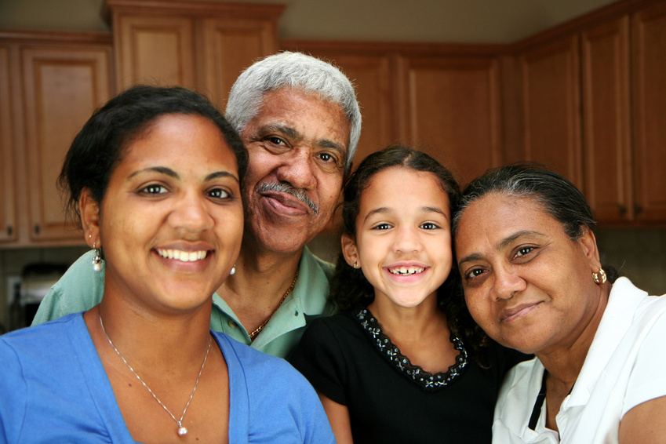
HEALING THE COMMUNITY
Family members have most often found healing and purpose when they join together for their own mutual support, love and advocacy.
Families utilize the community for resources for basic needs, safety security, belonging and needs.

Slide 36
HEALING THE COMMUNITY
The recommendation to seek help is particularly vital, considering the majority of people with diagnosable disorders, regardless of race or ethnicity, do not receive treatment in the community.
The stigma surrounding addiction is a powerful barrier to reaching treatment. People with addiction/mental illness feel shame and fear of discrimination about a condition that is as real and disabling as any other serious health condition.

Slide 37
FAMILY HEALING & RECOVERY PROCESS
Educate yourself on the recovery process for individuals and families.
If your recovering family member is living with you, provide a sober environment to support that recovery.
Seek professional and community peer support (from a group like Al-Anon) for your own physical and emotional health.
Support your family member's involvement in treatment aftercare meetings and recovery support groups.
Assist the recovering family member with assistance in locating sober housing, employment, child care, transportation or other recovery support needs.
Assertively re-intervene in the face of any relapse episode.

Slide 38
MAINTENANCE
ACTION non traditional recovery
PREPARATION for a Cultural Congruent Recovery
CONTEMPLATION
PRE-CONTEMPLATION
Self
Actualization
ESTEEM
(Respect)
Self, Family and community
LOVE
(Belonging,
being a part of the community) Emotional, fellowship
SAFETY & Security,
Companionship, information, instrumental (housing/employment) and emotional (trauma) community supports
Physiological
Food - Shelter - Job – Health crisis Clothing Emotional - Instrumental information Support
MASLOW’S HEIRARCHY OF NEEDS

Slide 39
CULTURES OF RECOVERY
Historical Trauma, Liberation, and Cultural Healing:
Addiction within communities of color is best viewed within the larger historical context of slavery, oppression, Trauma and disaster.
Such historical traumas destroy personal identity and hope, erode cultural sources of resilience, and fuel the appetite for anesthesia.
Recovery is best framed within the larger framework of liberation and personal/cultural survival.
To be personally and culturally meaningful, the recovery stories of African Americans may have to be nested within their larger history and contemporary experience as a people.

Slide 40
RECOVERY CULTURE
People recovering from addiction have evolved a language (e.g., “recovering”/”recovered”) and rituals (e.g., sobriety birthdays) to describe and celebrate their experience.
Language and rituals for family members is much less defined. Some refer to themselves as “families in recovery” or a “family member in recovery,” even though some family members felt such terms were ambiguous and confusing.
Some family do not play a role in the family member’s recovery but is happy for her/him/family.

Slide 41
AFRICAN AMERICAN CULTURAL RECOCERY
Catalytic Metaphors:
To achieve recovery, each addicted individual must find sense-making, life-transforming ideas that abort the rituals of drug use.
Such metaphors spark profound breakthroughs in perception of self and the world that in turn lead to dramatic reconstructions of personal identity and interpersonal relationships.
Linking AOD use to historical oppression, portraying alcohol and other drugs as weapons of continued oppression, and portraying sobriety as an act of resistance and liberation can serve such a transformative function for some African American clients.

Slide 42
Family (as system, subsystems and individuals) Adaptations to Progression of Addiction Family (as system, subsystems and individuals)
FAMILY ADAPTATIONS TO PROGRESSION OF ADDICTION
The family in response to addiction and the addiction-related deterioration in role performance of a family member.
Suggest that the marital or family environment is actually an agent in initiating and sustaining addiction
The former studies depict family members as innocent victims; the latter depict family members and particularly the wife of the male alcoholic as an “etiological agent” or a factor “complicating the illness.”

Slide 43
Throughout Stages of Long-term Recovery
“TRAUMA OF RECOVERY”
A major implication of this research is the notion that children and families go through a “trauma of recovery”—a readjustment of expectations required by their continued psychological isolation from the addicted parent going through early recovery (Brown, 1994).
The diversity of family life is as wonderful in its capacity for resilience as it is sometimes horrifying in its capacity for cruelty.
Each family must be its own model.
Intervention into families must be characterized by gentleness and humility rather than by clinical arrogance born of knowing THE truth about the impact of addiction and recovery on the family.

Slide 44
MY STORY – THE POWER OF STORY

Slide 45
THANK YOU!

Slide 46
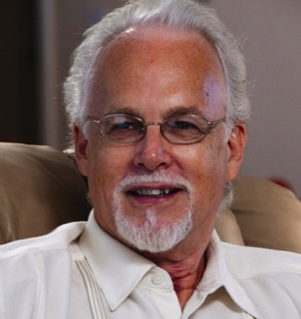
WEBINAR PRESENTER #2
William “Bill” White
Emeritus Senior Research Consultant
Chestnut Health Systems
bwhite@chestnut.org
www.williamwhitepapers.com

Slide 47
ADDICTION RECOVERY: MULTIPLE LEVELS OF HEALING
Personal Recovery: 3 core dimensions
Family Recovery: 5 family subsystems
Community Recovery (“Healing Forest”)
community subsystems (e.g., government, business, education, religious institutions, healthcare, social service, arts, sports, media, cultural subgroups, mutual aid)

Slide 48
RECOVERY CAPITAL (RC)
Recovery Capital = internal and external resources (at personal, family and community levels) that can be mobilized to initiate and sustain long-term recovery from severe AOD problems (Granfield & Cloud, 1999; White & Cloud, 2008)
PERSONAL RECOVERY CAPITAL
physical recovery capital: physical health, financial assets, health insurance, safe and recovery-conducive shelter, clothing, food, and access to transportation.
human recovery capital: values, knowledge, educational/vocational skills and credentials, problem solving capacities, self-awareness, self-esteem, hopefulness, meaning and purpose in life, interpersonal skills.

Slide 49
RECOVERY CAPITAL (RC)
Recovery Capital = internal and external resources (at personal, family and community levels) that can be mobilized to initiate and sustain long-term recovery from severe AOD problems (Granfield & Cloud, 1999; White & Cloud, 2008)
FAMILY/SOCIAL RECOVERY CAPITAL
encompasses recovery-supportive intimate relationships, family and kinship relationships (defined as family of choice), and social relationships

Slide 50
RECOVERY CAPITAL (RC)
Recovery Capital = internal and external resources (at personal, family and community levels) that can be mobilized to initiate and sustain long-term recovery from severe AOD problems (Granfield & Cloud, 1999; White & Cloud, 2008)
COMMUNITY RECOVERY CAPITAL
Encompasses community attitudes/policies/resources that promote the prevention and resolution of AOD problems.
Cultural capital is a form of community capital, e.g., local availability of culturally-prescribed pathways of recovery that resonate with particular individuals and families

Slide 51
ROLE OF RECOVERY CAPITAL IN PREDICTING LONG-TERM RECOVERY OUTCOMES
Science is confirming what front-line addiction professionals have long known: “environmental factors can augment or nullify the short-term influence of an intervention” (Moos, 2003, p. 3; Humphreys, Moos & Cohen, 1997).
Therapeutic processes in addiction treatment must encompass more than a strictly clinical intervention (Simpson, 2004).
Strategies that target family and community recovery capital can elevate long-term recovery outcomes and elevate the quality of life of individuals and families in long-term recovery (White, 2009).

Slide 52
AUDIENCE POLLING QUESTION Does your organization have one or more staff/volunteer positions dedicated to increasing recovery support resources in the communities you serve?

Slide 53
RECOVERY CAPITAL PRESCRIPTIONS
Support screening and brief intervention (SBI) programs that reach people before their recovery capital is depleted
Precovery: Engaging and motivating people at pre-action stages of change
Engage people with low recovery capital through aggressive community outreach.
Focus on hope as a recovery catalyst, e.g., myth of “hitting bottom”; pull (hope) forces versus push (pain) forces
Assess recovery capital on an ongoing basis, moving beyond pathology-based assessment technologies and monitoring RC over time
Use RC levels to help determine level of care placement decisions (See Matrix Below).
Embrace program/professional roles in community recovery capital development
Use RC measures to evaluation program/professional performance

Slide 54
RECOVERY CAPITAL & LEVEL OF CARE PLACEMENT DECISIONS
Recovery Capital/Problem Severity Matrix
High Recovery Capital
High Problem Severity/Complexity
Low Problem Severity/Complexity
Low Recovery Capital

Slide 55
MEASURING PERSONAL/FAMILY RECOVERY CAPITAL
Assessment of Recovery Capital Scale
50-item scale and scoring instructions posted at www.williamwhitepapers.com
Psychometrics published in Drug and Alcohol Review (Groshkova, Best & White, 2012)

Slide 56
STEPS FOR MEASURING COMMUNITY RECOVERY CAPITAL
Extensive problem data with little solution data; Need for recovery resource mapping
Plot problem indicator data by zip code/census tract/cities/counties/states, etc.
Plot recovery resource data by same catchment area, e.g., Tx resources, mutual aid meetings, recovery support institutions, etc. & by special populations, e.g., women, young people, etc.
Identify areas of high problem severity and low RC (and missing types of RC) for targeted development initiatives
See (Johnson, et al., 2009) for detailed description

Slide 57
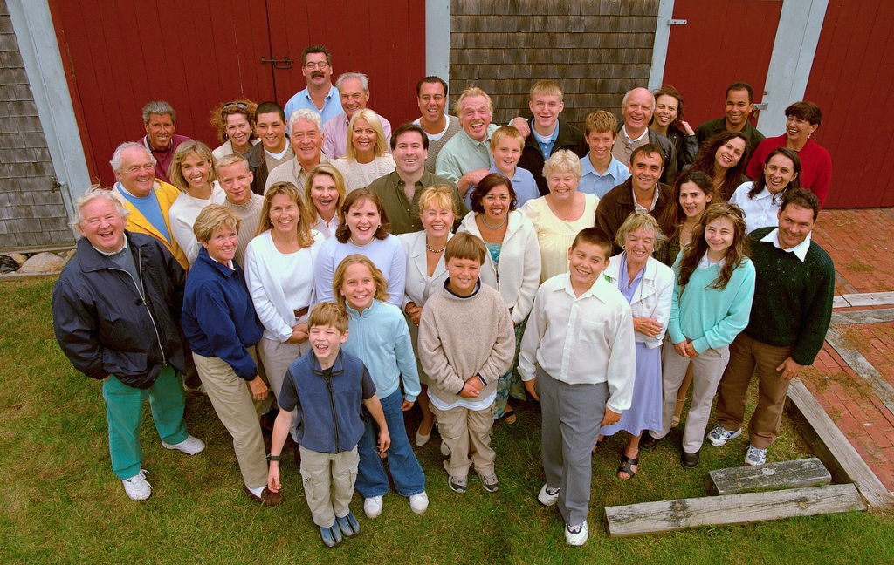
RECOVERY CARRIERS AS COMMUNITY RECOVERY CAPITAL
Recovery is contagious (White, 2010).
Recovery is spread via recovery carriers (White, 2012).
Prevalence of recovery carriers can be strategically increased.
Mechanisms: Alumni, volunteer, recovery coach, advocacy, educational, community service opportunities

Slide 58
CULTURES OF ADDICTION / CULTURES OF RECOVERY
Cultural elements: people (iconic figures), places (landmarks) & things (language, values, rituals, symbols, literature, art, music, etc.)
Styles of cultural affiliation (acultural, bicultural, enmeshed)
Recovery as a transcultural journey
Building cultures of recovery
(White, 1996)

Slide 59
KINETIC IDEAS FOR RECOVERY COMMUNITY DEVELOPMENT
Long-term addiction recovery is a reality.
In terms of stigma reduction, stories trump science.
There are multiple pathways of recovery—all are cause for celebration.
Recovery flourishes in supportive communities.
Recovering people, once part of the problem, can become part of the solution.
Local vanguards of recovering people can put faces and voices on recovery as living proof of these propositions.

Slide 60
ADDICTION TREATMENT AND COMMUNITY RECOVERY CAPITAL
Inreach
Outreach
Recovery Community Development (RCD) Activities
RCD specialists roles in future/incorporation into recovery coach activities
Integration of clinical and community development/cultural revitalization models
(White, 2002, 2003, 2009)

Slide 61
AUDIENCE POLLING QUESTION Does your organization offer services/support to individuals and families in later stages of recovery?

Slide 62
PERSONAL/FAMILY RECOVERY SUPPORT THROUGH STAGES OF RECOVERY
From AC to RM models of recovery support
Greatest need for “therapy” may be after period of recovery initiation and stabilization (Dennis, Foss, & Scott, 2007)
Ameliorating the “trauma of recovery” (Brown & Lewis, 1999)
Providing “scaffolding” for sustained family recovery across the family life cycle (White & Brown, 2011)

Slide 63
BREAKING INTERGENERATIONAL CYCLES
Addressing historical trauma (Brave Heart, et al, 2011, 1998) and cultural revitalization (Coyhis, 2000, Coyhis & White, 2006)

Slide 64
BREAKING INTERGENERATIONAL CYCLES
Family/children’s programs integrated into addiction treatment and recovery support services
Enhancing effectiveness of parents in recovery, e.g., integrating parenting education into treatment and post-treatment recovery support services

Slide 65
BREAKING INTERGENERATIONAL CYCLES
Targeted prevention activities for children with family histories of addiction
Early intervention strategies aimed at preventing/shortening addiction careers

Slide 66
THANK YOU!

Slide 67
ASKING QUESTIONS
Ask questions through the Questions Pane

Slide 68
OTHER RTP WEBINARS
Defining Addiction Recovery
Wednesday, February 13, 2013 @ 3-4pm EST
What Does Science Say? Reviewing Recovery Research
Thursday, February 28, 2013 @ 12-1:30pm EST
Defining Recovery-Oriented Systems of Care (ROSC)
Wednesday, March 13, 2013 @ 3-4pm EST
The History of Recovery in the United States and the Addiction Profession
Tuesday, March 26, 2013 @ 12-1:30pm EST
Using Recovery-Oriented Principles in Addiction Counseling Practice
Wednesday, April 10, 2013 @ 3-5pm EST
Understanding the Role of Peer Recovery Coaches in the Addiction Profession
Tuesday, April 23, 2013 @ 12-1:30pm EST
Including Family and Community in the Recovery Process
Wednesday, May 8, 2013 @ 3-5pm EST
Collaborating with Other Professions, Professionals, and Communities
Tuesday, June 4, 2013 @ 3-4pm EST
Exploring Techniques to Support Long-Term Addiction Recovery for Clients and Families
Wednesday, June 19, 2013 @ 3-5pm EST
www.naadac.org/education/webinars

Slide 69
WEBINARS ON DEMAND
Medication Assisted Treatment
Building Your Business with SAP/DOT
SBIRT
Billing and Claim Submission
Ethics
Co-occurring Disorders
Test-Taking Strategies
Conflict Resolution
Clinical Supervision
ASAM Placement Criteria
DSM-5 Proposed Changes
www.naadac.org/education/webinars
CE credit still available!
Free to NAADAC Members!

Slide 70
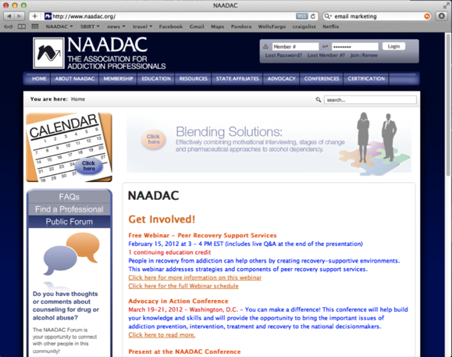
WWW.NAADAC.ORG

Slide 71
The clinical tools you need. The customer support you deserve.
That’s why Orion Healthcare Technology is the preferred software vendor of NAADAC.
Assessments and Screening
Patient Placement
Treatment Planning
Progress Notes
Discharge Summaries
Insurance Billing
Reporting and Tracking
Prevention Tracking
For more information: Click: www.MyAccuCare.com
Call: (800)324-7966

Slide 72
OBTAINING CE CREDIT
The education delivered in this webinar is FREE to all professionals.
2 CEs are FREE to NAADAC members and AccuCare subscribers who attend this webinar. Non-members of NAADAC or non-subscribers of AccuCare receive 2 CEs for $25.
If you wish to receive CE credit, you MUST complete and pass the “CE Quiz” that is located at: (look for TITLE of webinar)
www.naadac.org/education/webinars
www.myaccucare.com/webinars
A CE certificate will be emailed to you within 21 days of submitting the quiz and payment (if applicable) – usually sooner.
Successfully passing the “CE Quiz” is the ONLY way to receive a CE certificate.
Free to NAADAC Members and AccuCare Subscribers

Slide 73
NAADAC, The Association for Addiction Professionals
1001 N. Fairfax St. Suite 201 Alexandria, VA 22314 p 800.548.0497 f 800.377.1136
www.myaccucare.com
sskarda@orionhealthcare.com
NAADAC
NAADACorg
Naadac
misti@naadac.org
Bill White – bwhite@chestnut.org
Joe Powell – Joep2722@aol.com
Thank You for Participating!
www.naadac.org/education/recovery

